Slide 1

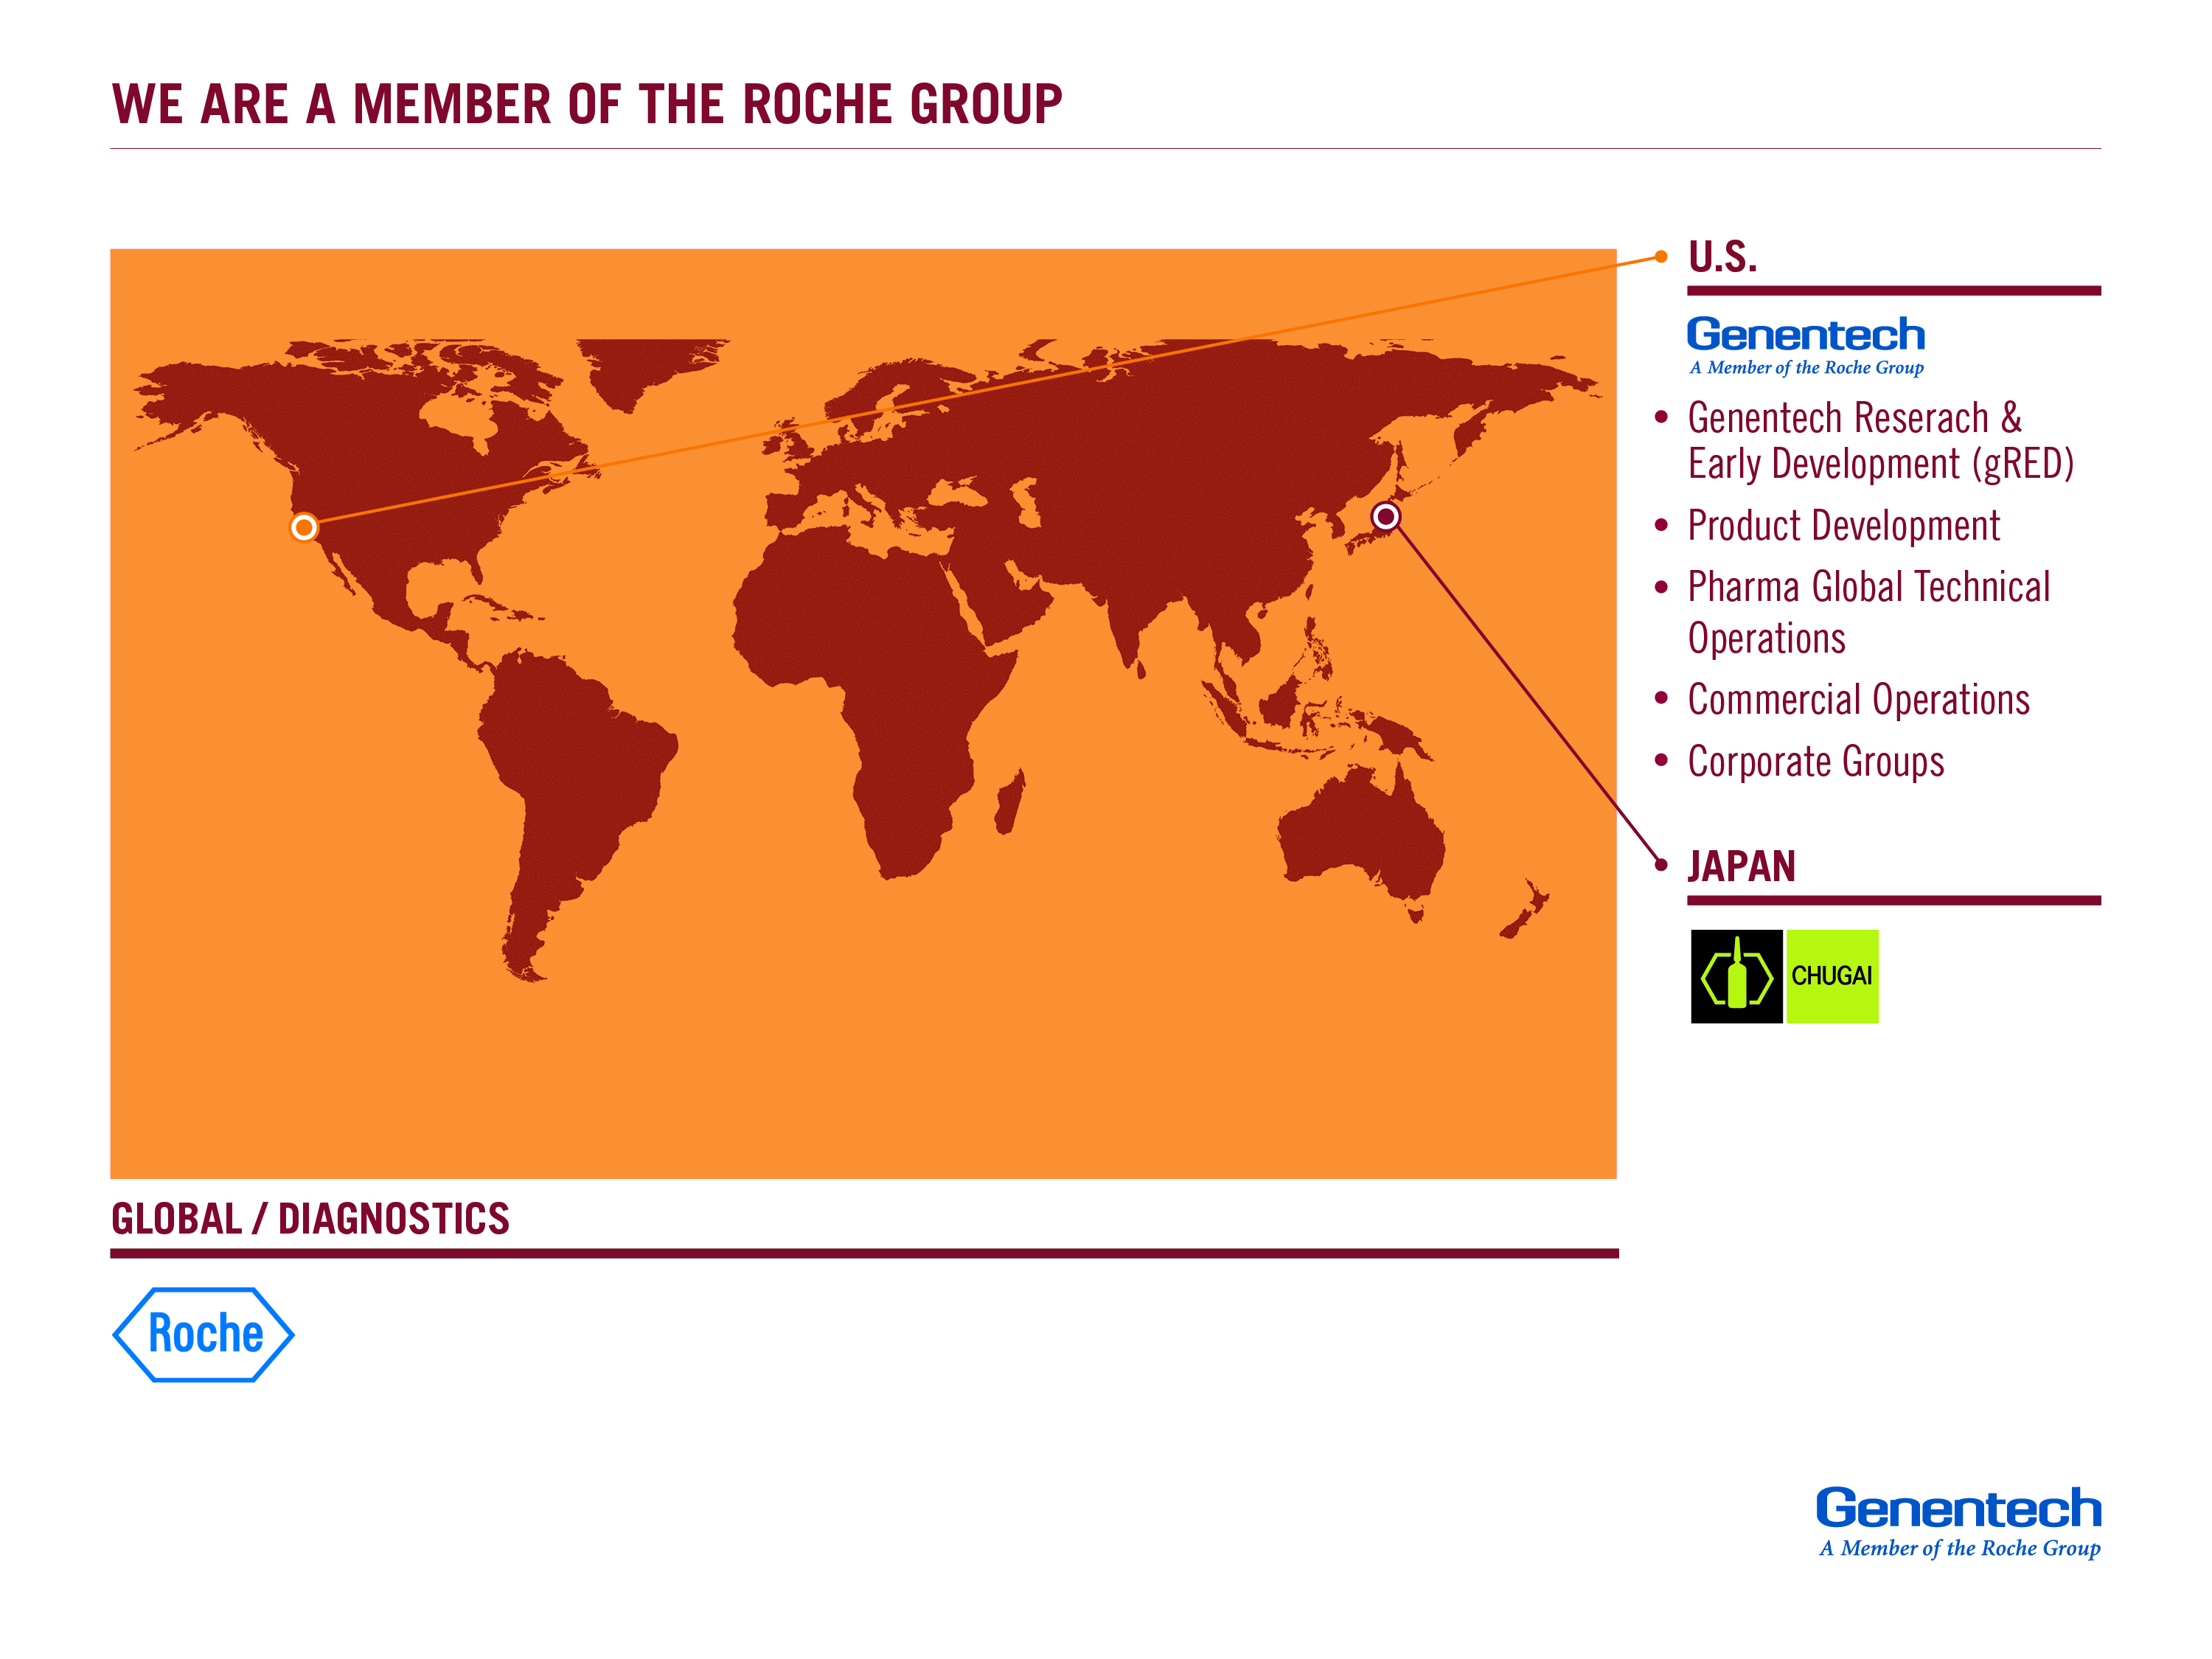
PILLS General Meeting: UC Berkeley
02/23/2016

Slide 2


Slide 3


Slide 4
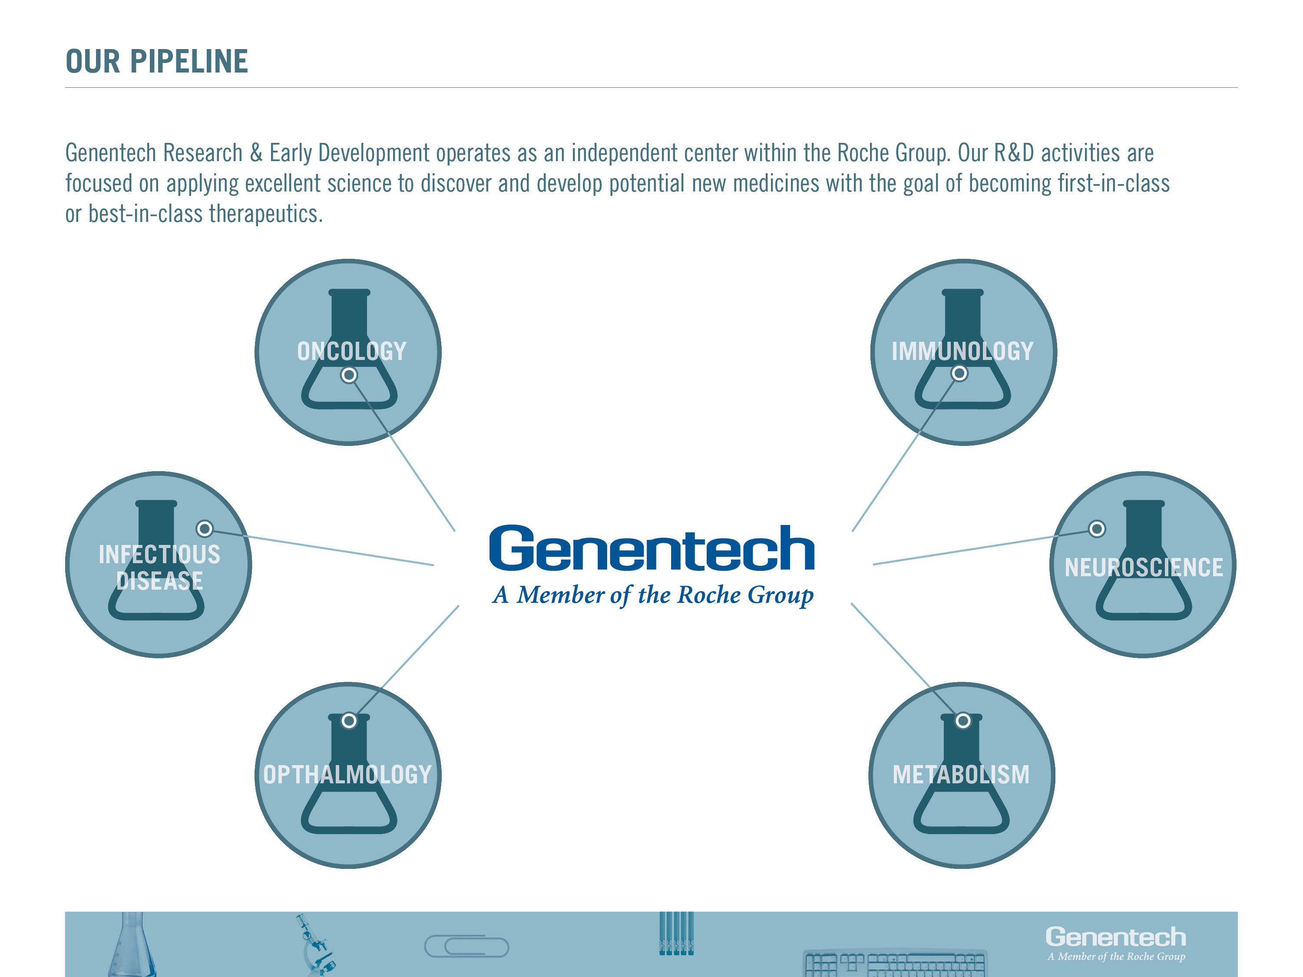

Slide 5
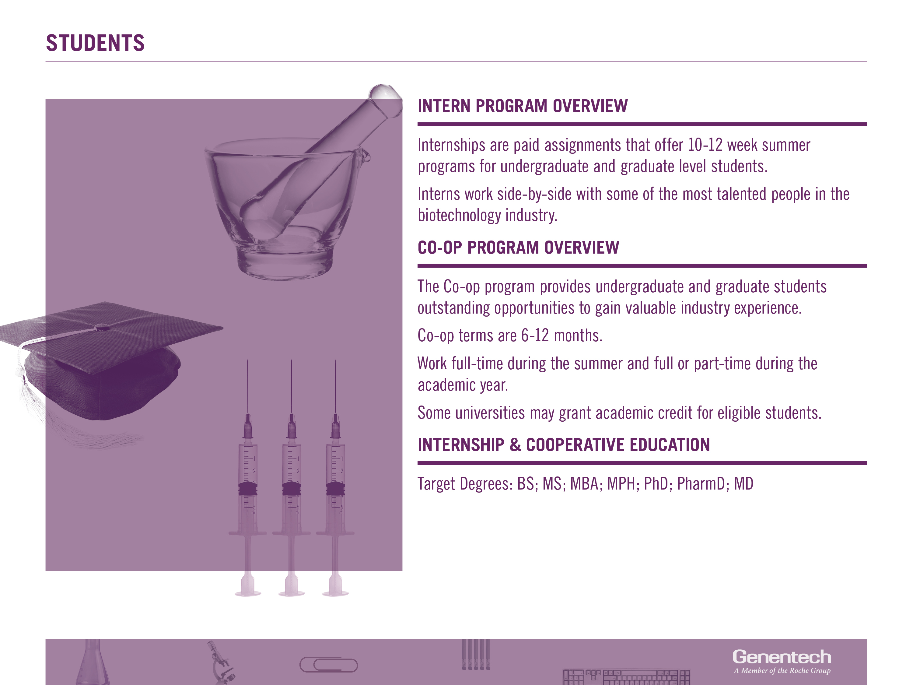

Slide 6
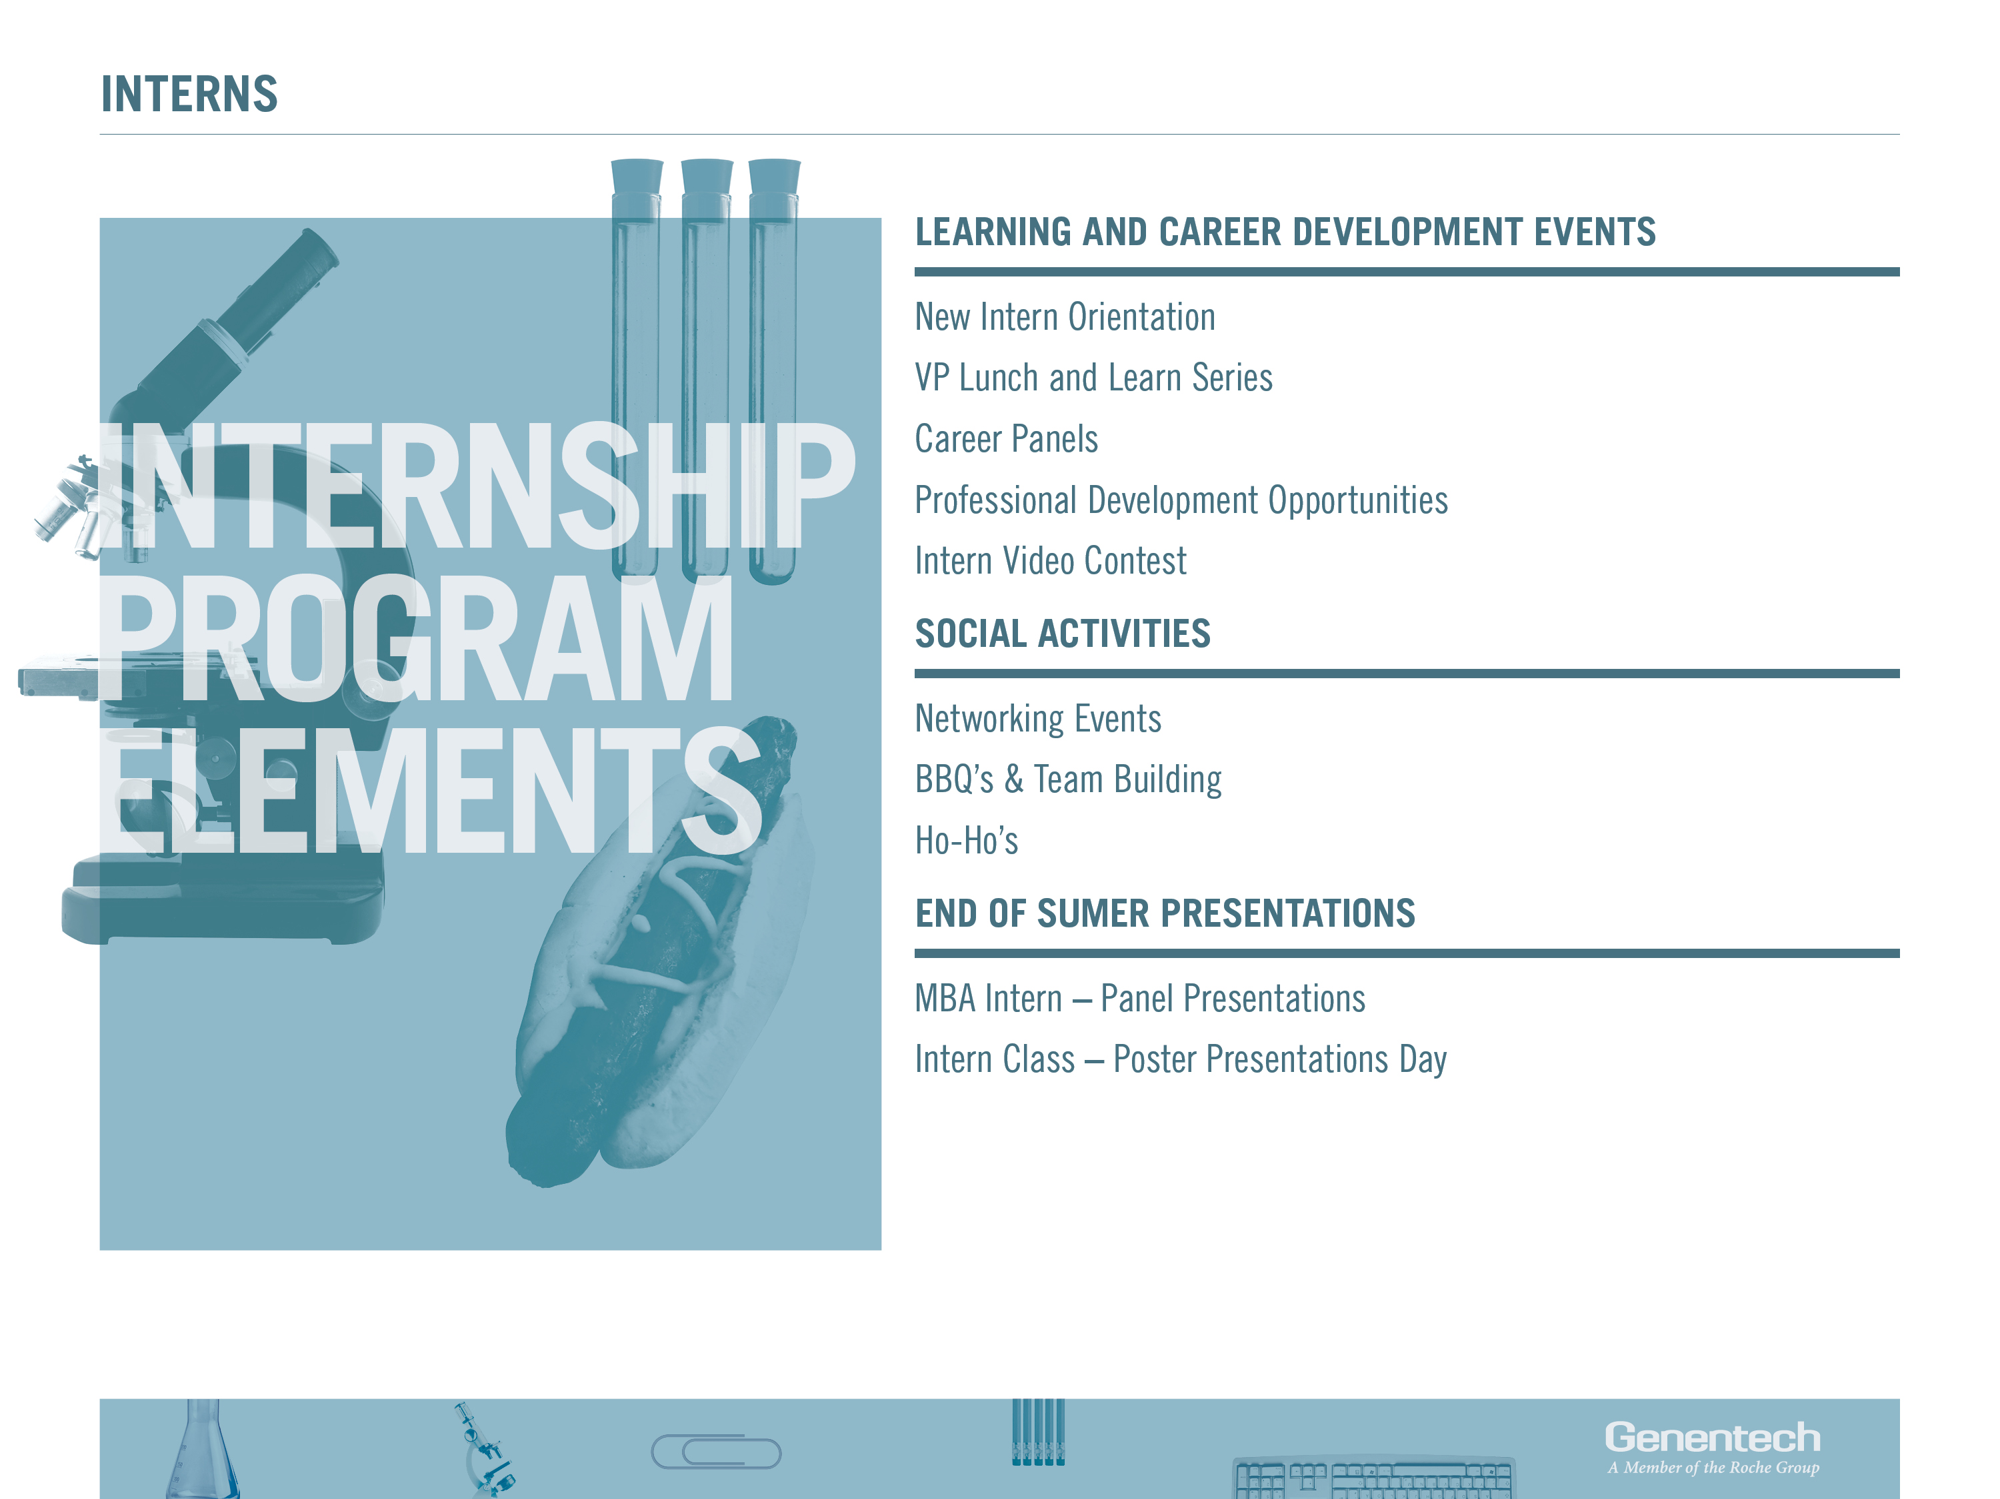

Slide 7
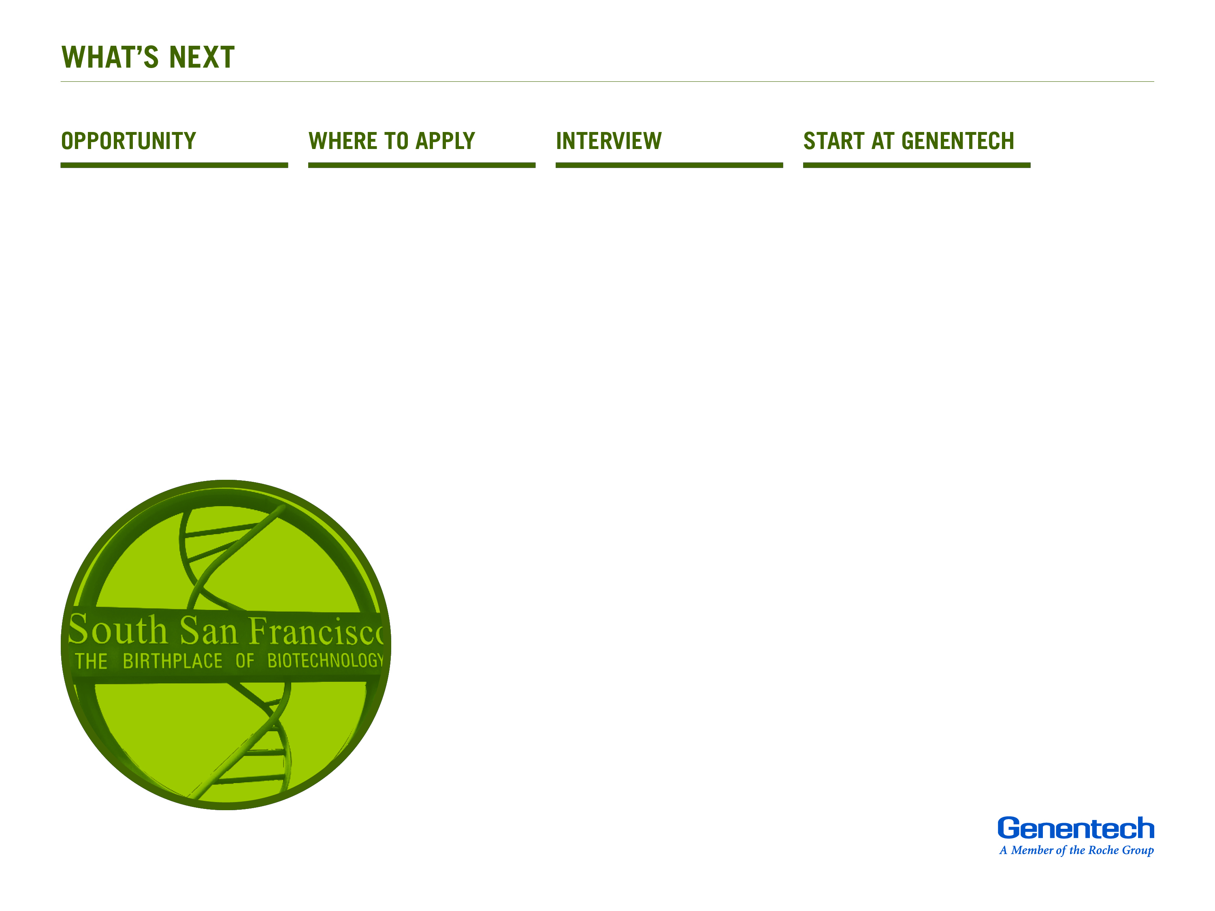
Search internship opportunities at Genentech in January / February.
Apply online at
career.gene.com
Search for “internship / student” under the job category.
If your qualifications are a match, hiring managers will contact you for an interview in March / April.
Internships typically run from end of May through early September – depending on school schedules.

Slide 8


